Slide 1
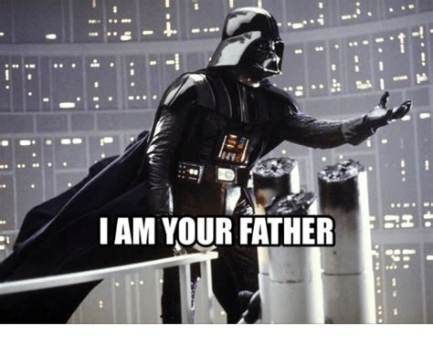

Slide 2
Module 1-11
Inheritance

Slide 3
Objectives
Should be able to describe the purpose and use of inheritance
Should be able to, given an existing set of classes, properly identify subclasses and superclasses
Should be able to properly define and use superclasses and subclasses in an inheritance hierarchy

Slide 4
Principles of Object-Oriented Programming (OOP)
Encapsulation - the concept of hiding values or state of data within a class, limiting the points of access
Inheritance - the practice of creating a hierarchy for classes in which descendants obtain the attributes and behaviors from other classes
Polymorphism - the ability for our code to take on different forms
(Abstraction) – extension of encapsulation. We can’t build a car from scratch, but we know how to use (drive) it.
Inheritance!

Slide 5

Inheritance
Real world objects can exhibit parent-child relationships. Consider the following examples:
Humans, dogs, elephants, and whales are clearly quite different from each other, but they have enough similarities prompting biologists to classify them as mammals.
Cars, motorcycles, and trucks are all motor vehicles, but they each have sufficient differences for the Department of Motor Vehicles to regulate them differently.
In finance, the word account can refer to a checking account, a savings account, or mutual fund, but they all share similarities like a monthly balance and account holder name.

Slide 6
Inheritance
Java and most modern programming languages provide powerful tools that enable developers to model these parent-child relationships.
More specifically in Java one class can be classified as a child of a parent class.
The child class can inherit properties and methods defined by the parent.
Inheritance can take on several forms:
A concrete class (all the classes we have seen so far) inheriting from another concrete class.
A concrete class inheriting from an abstract class.
A concrete class inheriting from an Interface.

Slide 7


Inheritance
Described as:
Parent – child relationship
Superclass – subclass relationship
Base – derived relationship
A race-horse is a type horse
A savings account is a type of bank account
A tarantula is a type of spider
Described as an “is-a” relationship – goes one-way, not all spiders are tarantulas.

Slide 8
Inheritance: Declaration
In this module, we will explore the situation where two concrete classes have a parent child relationship. A child class that will inherit from a parent must be defined following this syntax:
public class <<Name of Child Class>> extends <<Name of Parent Class>> {
… // rest of your class declaration
}

Slide 9
Inheritance Example
Vehicle has defined several methods and data members. In this example, Vehicle serves as the parent class.
Car is a child class of Vehicle.. Note how it is able to call Vehicle’s methods. The extends syntax is used to create this relationship.
package te.mobility;
public class Vehicle {
private int numberOfWheels = 4;
private double engineSize;
private String bodyColor;
public int getNumberOfWheels() {
return numberOfWheels;
}
public void setNumberOfWheels(int numberOfWheels) {
this.numberOfWheels = numberOfWheels;
}
}
package te.mobility;
public class Car extends Vehicle {
public void report() {
System.out.println(super.getNumberOfWheels());
// 0, inherited from parent class which will have the
// default value for integers.
super.setNumberOfWheels(4);
// we are calling the setter defined on its parent
System.out.println(super.getNumberOfWheels());
// 4
}
}
We use the super keyword to refer to the parent’s members and variables.

Slide 10
Inheritance Example
Here we define another child class of Vehicle called Truck.
We now have a parent class with 2 child classes. Vehicle is the parent class. Both Truck and Car extends from vehicle, making them child classes of the vehicle.
package te.mobility;
public class Truck extends Vehicle {
public void report() {
super.setNumberOfWheels(10);
// we are calling the setter defined on its parent
}
public void coupleCargoContainer() {
System.out.println(“coupling cargo container”);
super.setNumberOfWheels(18);
}
}
The Truck class has its own unique method, it has a method called coupleCargoContainer() which is unique to the Truck class, and not part of the Vehicle or Car class.

Slide 11
Inheritance Example
public class GarageDemo {
public static void main(String args[]) {
Car myCar = new Car();
myCar.setup();
System.out.println(myCar.getNumberOfWheels());
Truck myTruck = new Truck();
myTruck.setup();
System.out.println(myTruck.getNumberOfWheels());
myTruck.coupleCargoContainer();
System.out.println(myTruck.getNumberOfWheels());
// This is an invalid call:
//myCar.coupleCargoContainer();
}
}
Suppose have an orchestrator class called GarageDemo with a main method that will instantiating new cars and trucks based on the setup we’ve established so far.
Output will be 4
Output will be 10
Output will be 18
This is an invalid statement, the coupleCargoContainer method is unique to the Truck class.

Slide 12
Effect of Private Modifiers on Inheritance
The access modifiers present on the parent class’ data members is not trivial.
Data members and methods marked as private on a parent class cannot be inherited by a child class.
Data members and methods marked as protected can be inherited by a child class even if it’s on a different package.
************ Limit the accessibility as much as possible *************
Use private, unless you must use protected. Use protected, unless you must use public. Never use public on an instance variable!

Slide 13
Effect of Private Modifiers on Inheritance
Consider the following example:
public class Vehicle {
...
private String privateMethod() {
return "private";
}
…
}
public class GarageDemo {
public static void main(String args[]) {
Car myCar = new Car();
myCar.setup();
myCar.privateMethod();
…
}
}
This is an invalid call.
We are assuming that the Car class extends from Vehicle like on the previous examples.

Slide 14
Constructors with inheritance
public class Vehicle {
...
public Vehicle() {
System.out.println(“Vehicle”);
}
…
}
public class GarageDemo {
public static void main(String args[]) {
Truck myTruck = new Truck();
…
}
}
public class Truck extends Vehicle {
...
public Truck() {
System.out.println(“Truck”);
}
…
}
Output will be:
Vehicle
Truck

Slide 15
Constructors on Parent Classes
If a parent has implemented a constructor, a child class must add a call using super(...) to invoke the parent’s constructor with the correct arguments.
The syntax of super(...) is as follows:
public ChildClass(<<argument 1>>, <<argument2>>, ….) {
super(<<argument1>>, <<argument2>>, ...);
}
The arguments listed are arguments on the parent’s constructors

Slide 16
Constructors on Parent Classes: Example
package te.mobility;
public class Vehicle {
private int numberOfWheels;
private double engineSize;
private String bodyColor;
public Vehicle(int numberOfWheels, double engineSize, String bodyColor) {
this.numberOfWheels = numberOfWheels;
this.engineSize = engineSize;
this.bodyColor = bodyColor;
}
…
}
There is now a constructor in the parent Vehicle class.

Slide 17
Constructors on Parent Classes: Example
Note how the child class, Truck will now have to implement a constructor with a super(...) call.
public class Truck extends Vehicle {
public Truck(int numberOfWheels, double engineSize, String bodyColor) {
super(numberOfWheels, engineSize, bodyColor);
}
...
}
The super(...) call is a call to the parent constructor, providing any required parameters
public class Vehicle {
...
public Vehicle(int numberOfWheels, double engineSize, String bodyColor) {
this.numberOfWheels = numberOfWheels;
this.engineSize = engineSize;
this.bodyColor = bodyColor;
}
…
}

Slide 18
Constructors on Parent Classes: Example
In the Garage orchestrator class note how we are able to instantiate a new Truck with the constructor.
package te.main;
import te.mobility.Truck;
public class GarageDemo {
public static void main(String args[]) {
Truck cargoTruck = new Truck(10, 14.8, "red");
}
}

Slide 19
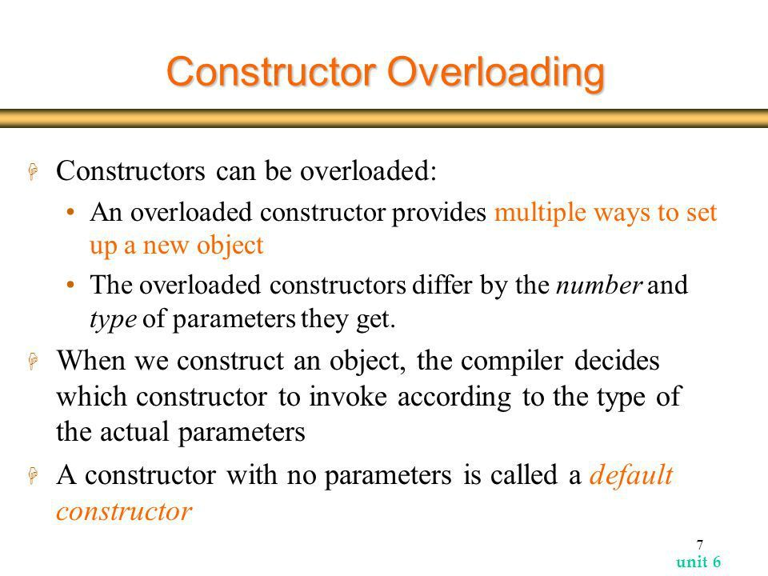
Multiple Constructors
Classes can contain more than one constructor, each taking a different number of arguments.
We are overloading the constructor (just like we can overload any other method)

Slide 20
Multiple Constructors Example
Consider the following example:
public class Vehicle {
private int numberOfWheels;
private double engineSize;
private String bodyColor;
public Vehicle(int numberOfWheels, double engineSize, String bodyColor) {
this.numberOfWheels = numberOfWheels;
this.engineSize = engineSize;
this.bodyColor = bodyColor;
}
public Vehicle(int numberOfWheels, double engineSize) {
this.numberOfWheels = numberOfWheels;
this.engineSize = engineSize;
}
…
}
Note that there is now a second constructor that does not take a bodyColor argument.

Slide 21
Multiple Constructors Example
public class Truck extends Vehicle {
public Truck(int numberOfWheels, double engineSize, String bodyColor) {
super(numberOfWheels, engineSize, bodyColor);
}
public Truck(int numberOfWheels, double engineSize) {
super (numberOfWheels, engineSize);
}
Note how the child class has also implemented a matching second constructor and called the 2 argument parent constructor using super.

Slide 22

Objectives
Should be able to describe the purpose and use of inheritance

Slide 23
Objectives
Should be able to describe the purpose and use of inheritance
Should be able to, given an existing set of classes, properly identify subclasses and superclasses

Slide 24
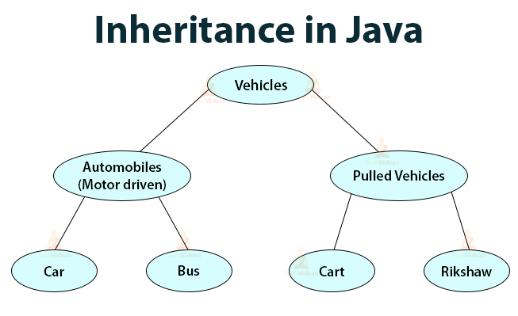
Objectives
Should be able to describe the purpose and use of inheritance
Should be able to, given an existing set of classes, properly identify subclasses and superclasses
Should be able to properly define and use superclasses and subclasses in an inheritance hierarchy

